Slide 1
Ethernet

Slide 2
Objectives
Identify the basic characteristics of network media used in Ethernet.
Describe the physical and data link features of Ethernet.
Describe the function and characteristics of the media access control method used by Ethernet protocol.
Explain the importance of Layer 2 addressing used for data transmission and determine how the different types of addressing impacts network operation and performance.
Compare and contrast the application and benefits of using Ethernet switches in a LAN as apposed to using hubs.
Explain the ARP process.

Slide 3
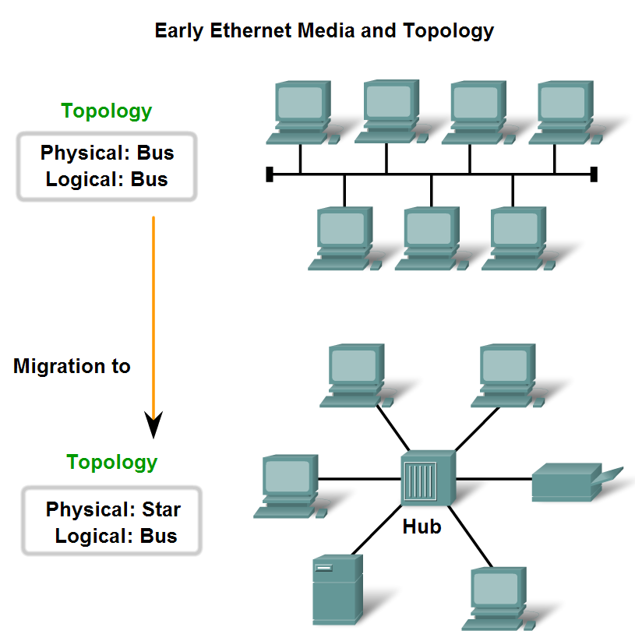
Characteristics of Network Media used in Ethernet

Slide 4
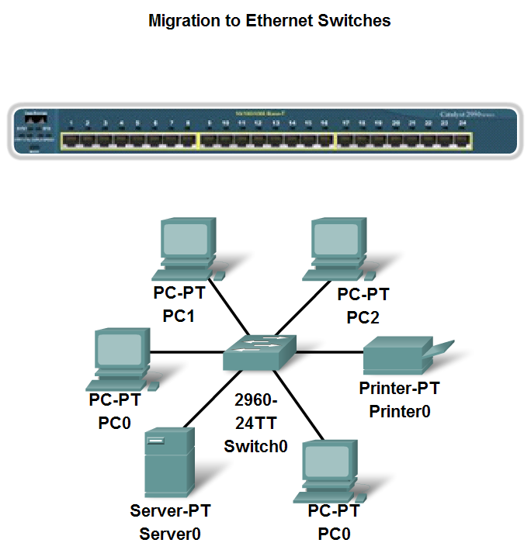
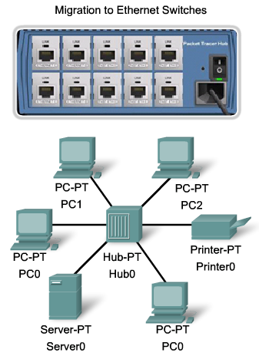
Characteristics of Network Media used in Ethernet

Slide 5
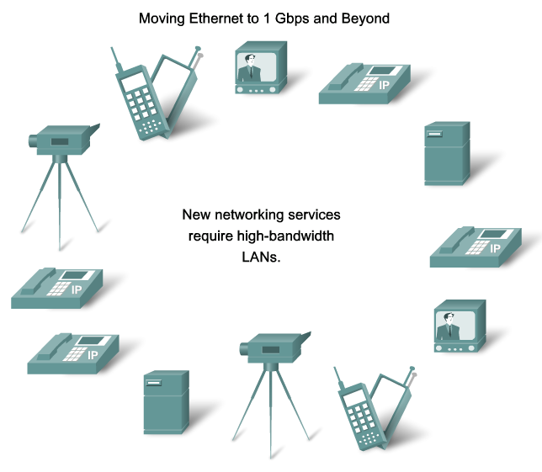
Characteristics of Network Media used in Ethernet

Slide 6
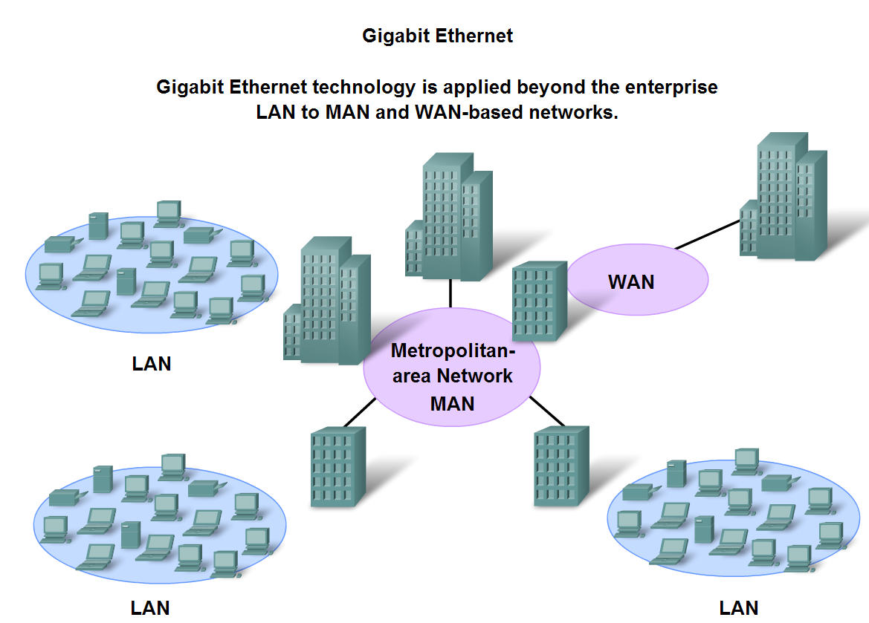
Characteristics of Network Media used in Ethernet

Slide 7
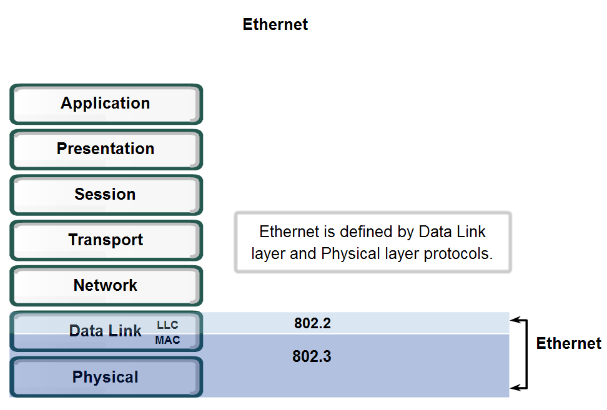
Physical and Data Link Features of Ethernet
Standards and Implementation

Slide 8
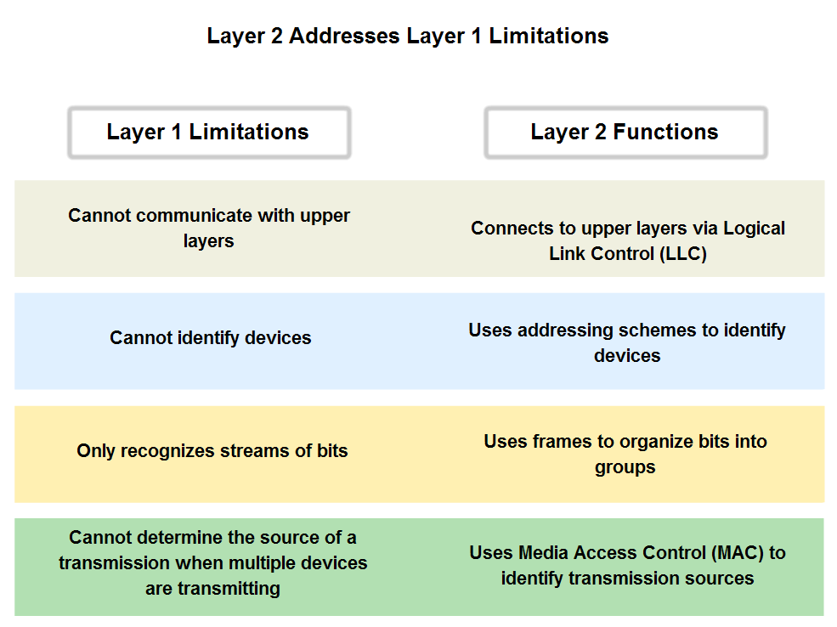
Physical and Data Link Features of Ethernet

Slide 9
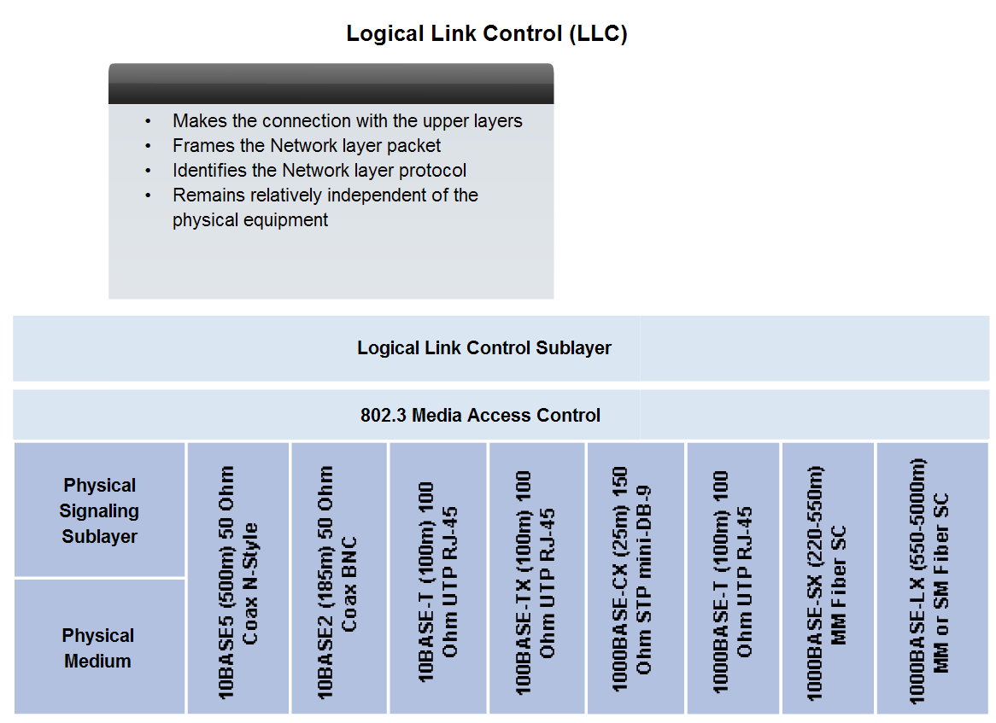
Physical and Data Link Features of Ethernet

Slide 10
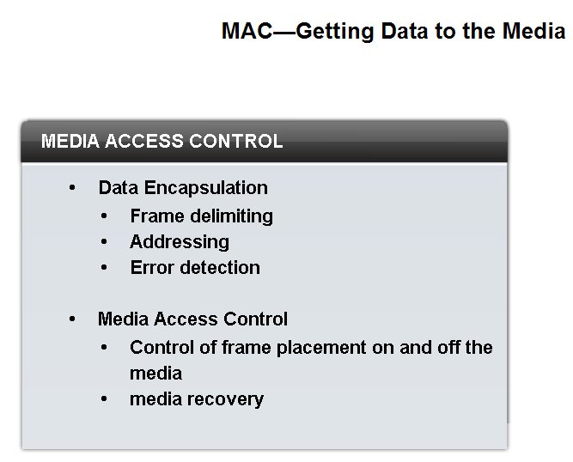
Physical and Data Link Features of Ethernet
Media Access Control (MAC)

Slide 11
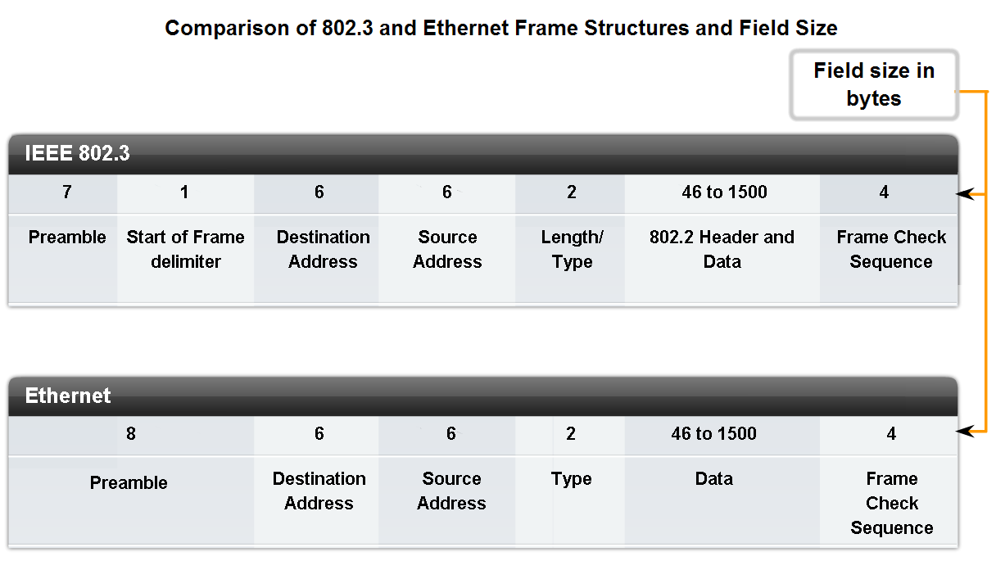
Layer 2 addressing and its Impact on Network Operation and Performance
The Frame – Encapsulating the Packet

Slide 12
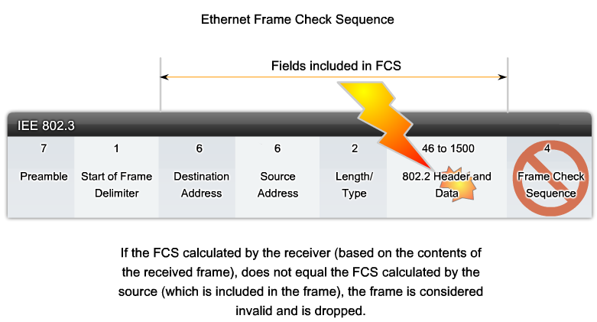
FCS

Slide 13
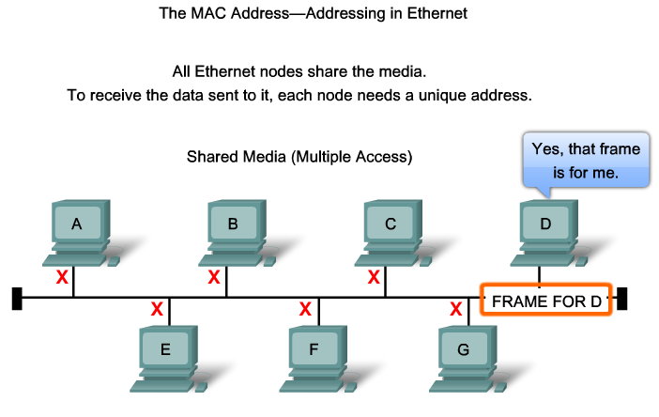
MAC Address

Slide 14
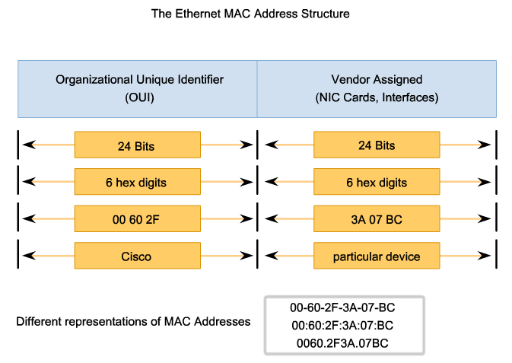
MAC Address

Slide 15
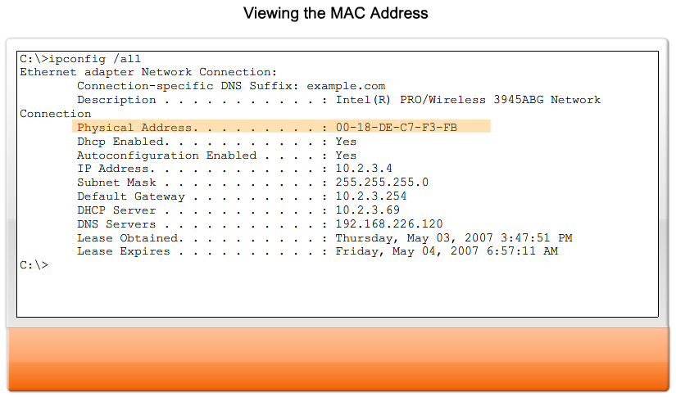
MAC Address

Slide 16
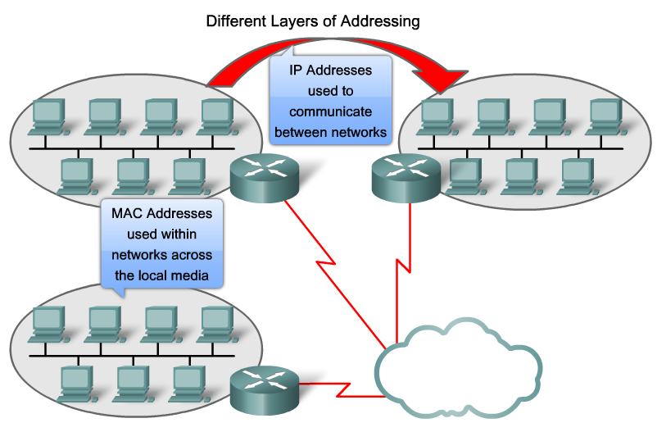
MAC Address Vs IP Address

Slide 17
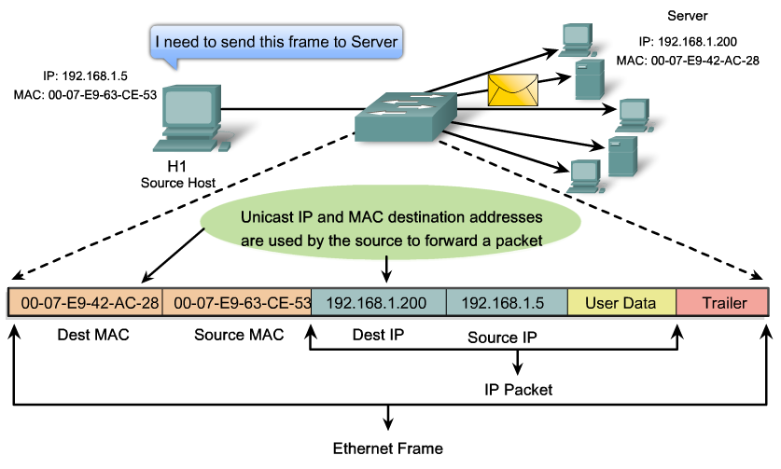
MAC Address Vs IP Address

Slide 18
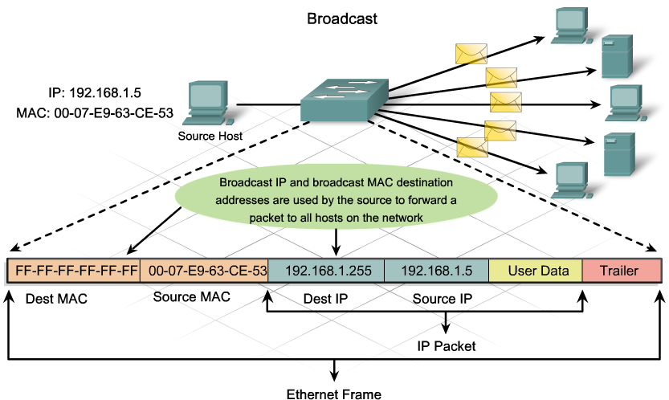
MAC Address Vs IP Address

Slide 19
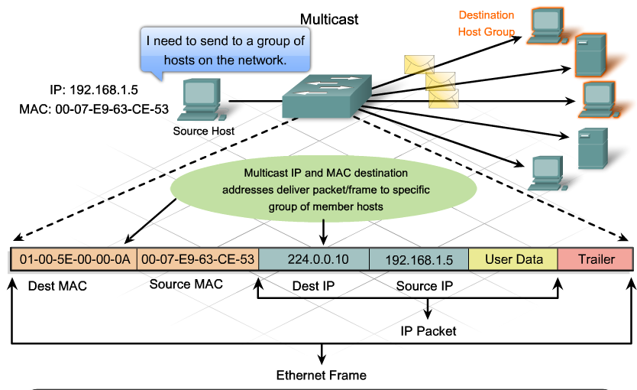
MAC Address Vs IP Address

Slide 20
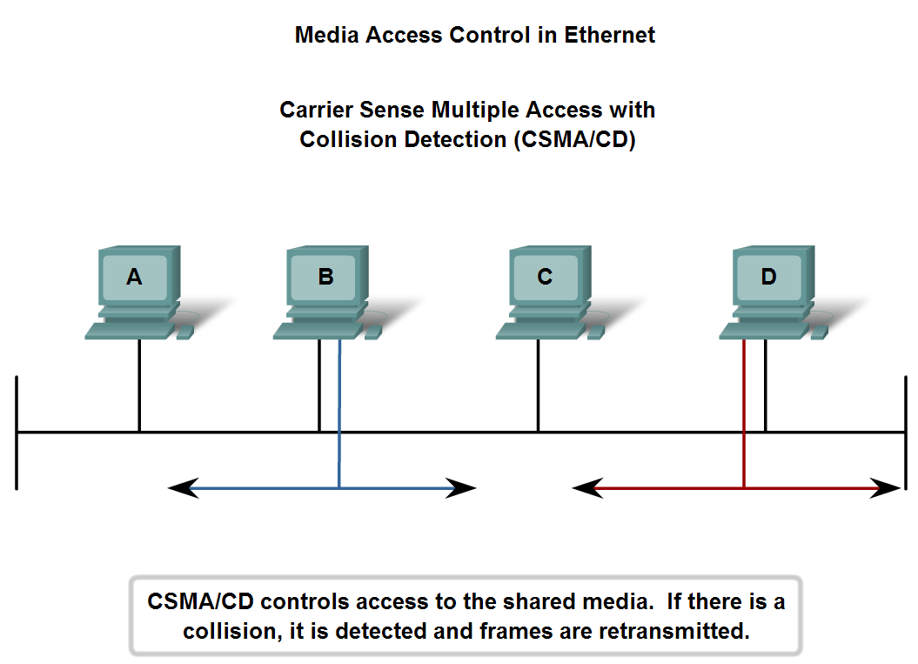
Carrier Sense Multiple Access with Collision Detection CSMA/CD

Slide 21
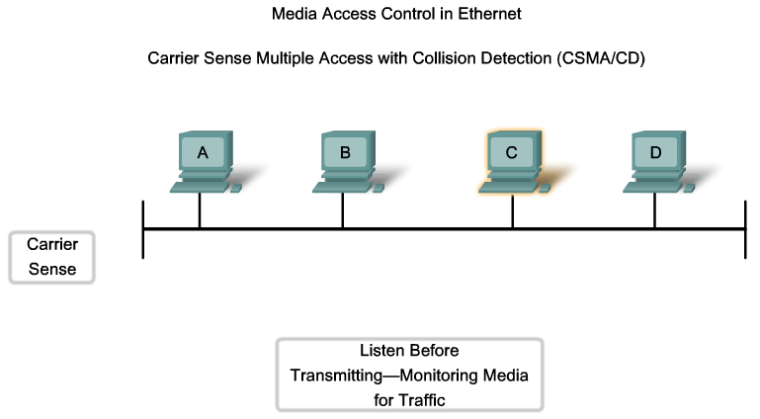
Carrier Sense Multiple Access with Collision Detection CSMA/CD

Slide 22
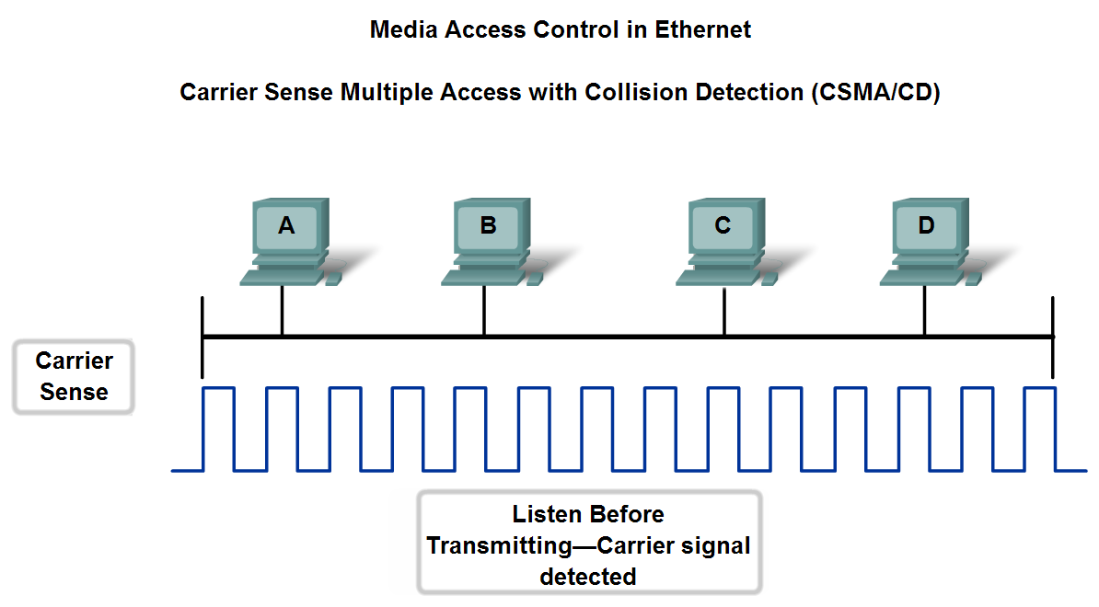
Carrier Sense Multiple Access with Collision Detection CSMA/CD

Slide 23
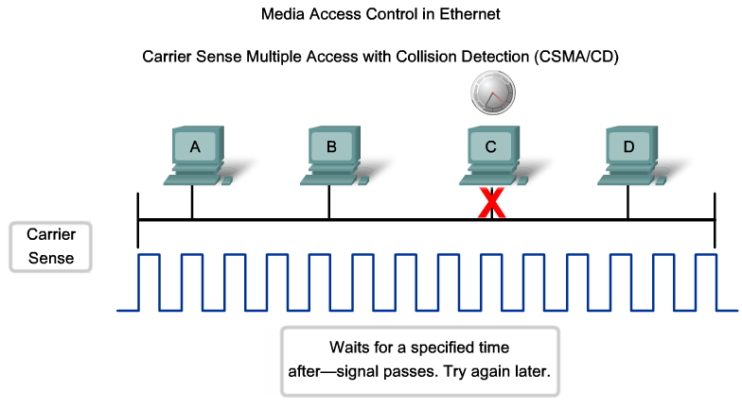
Carrier Sense Multiple Access with Collision Detection CSMA/CD

Slide 24
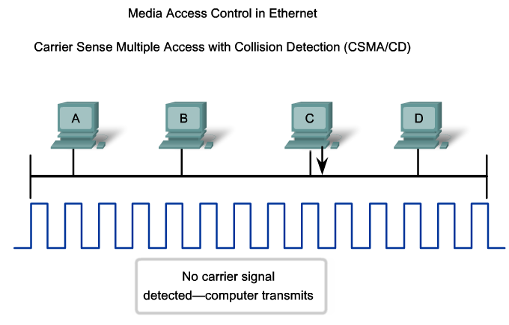
Carrier Sense Multiple Access with Collision Detection CSMA/CD

Slide 25
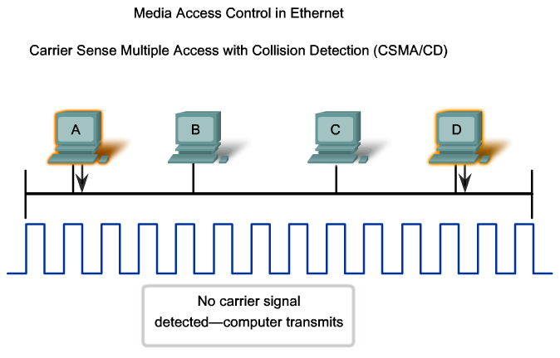
Carrier Sense Multiple Access with Collision Detection CSMA/CD

Slide 26
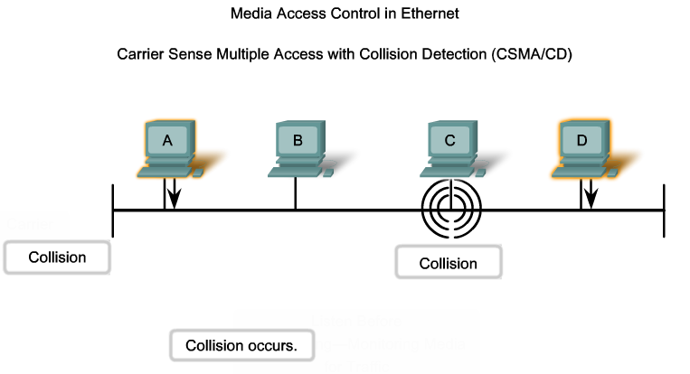
Carrier Sense Multiple Access with Collision Detection CSMA/CD

Slide 27
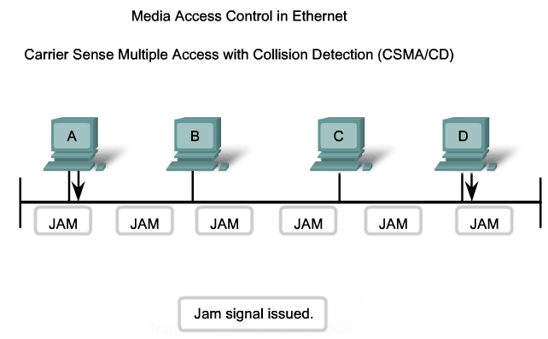
Carrier Sense Multiple Access with Collision Detection CSMA/CD

Slide 28
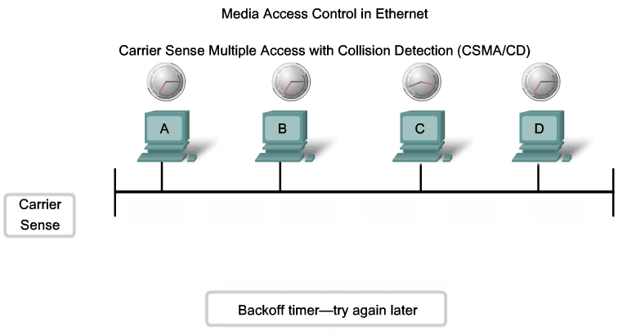
Carrier Sense Multiple Access with Collision Detection CSMA/CD

Slide 29
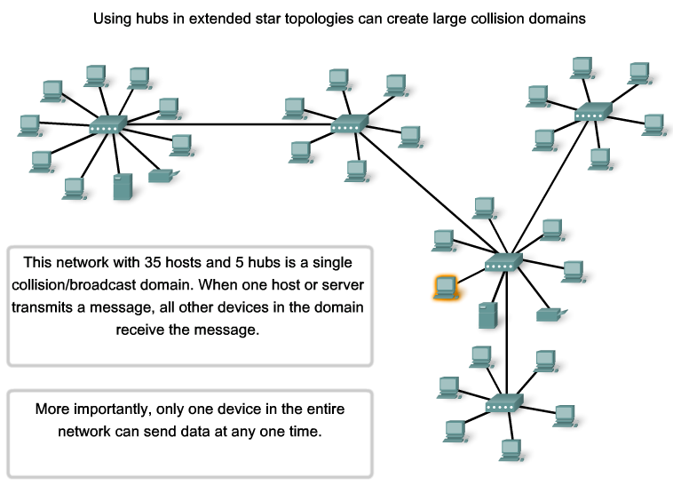
Collision Domain

Slide 30
Collision & Broadcast Domains
No. of Broadcast domains= No. of every active interface of the Routers
No. of collision domains = No. of every active interface of the Switches & Routers

Slide 31
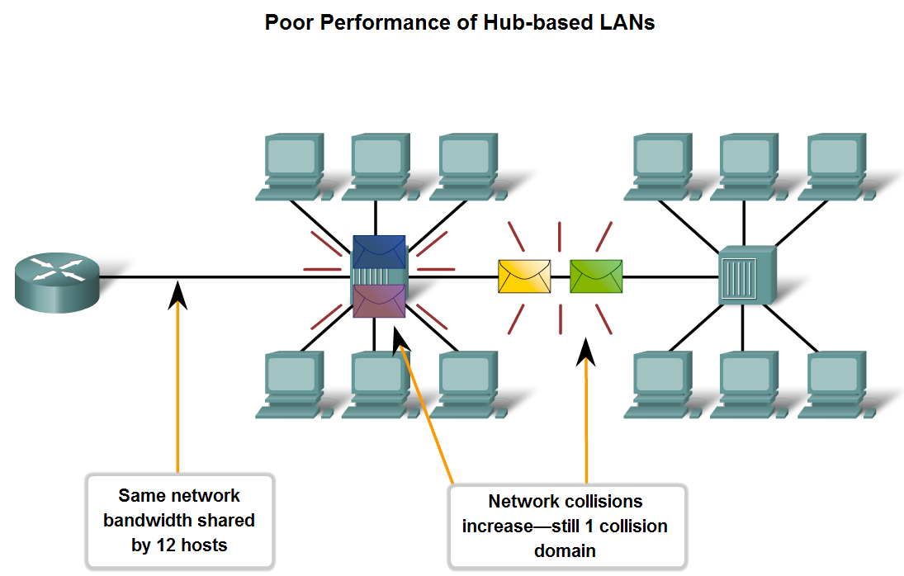
Compare and Contrast the Use of Ethernet Switches versus Hubs in a LAN.
Legacy Ethernet – Using Hubs

Slide 32
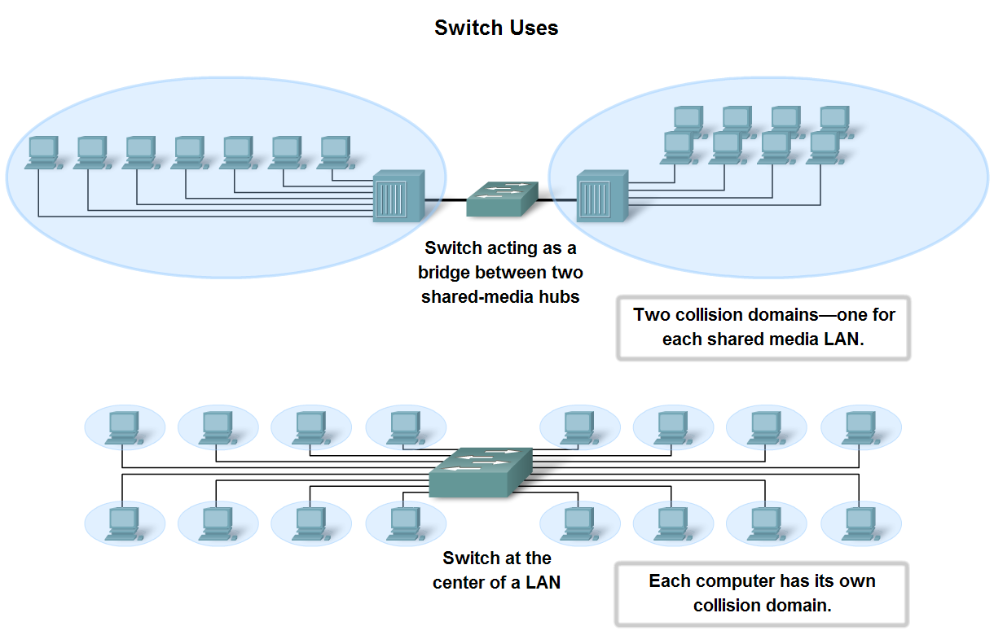
Compare and Contrast the Use of Ethernet Switches versus Hubs in a LAN.
Ethernet Switches improve network performance by increasing the number (Segmenting) of Collision Domain

Slide 33
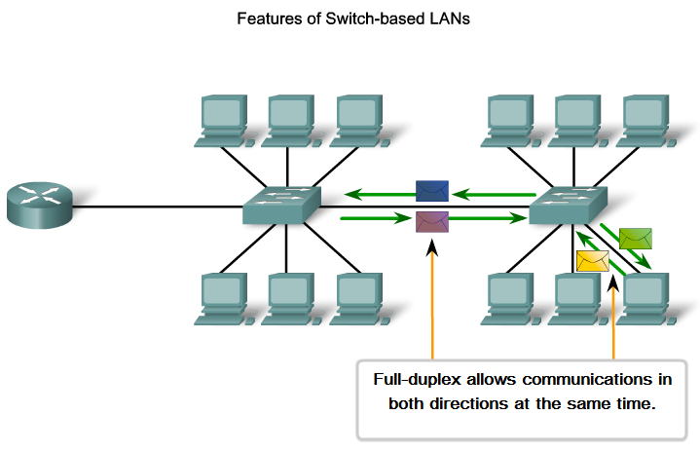
Compare and Contrast the Use of Ethernet Switches versus Hubs in a LAN.

Slide 34
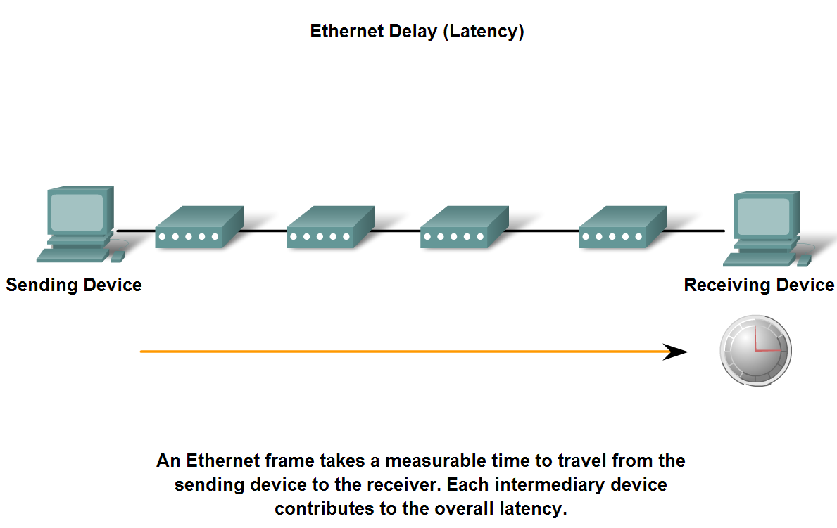
Ethernet Characteristics

Slide 35
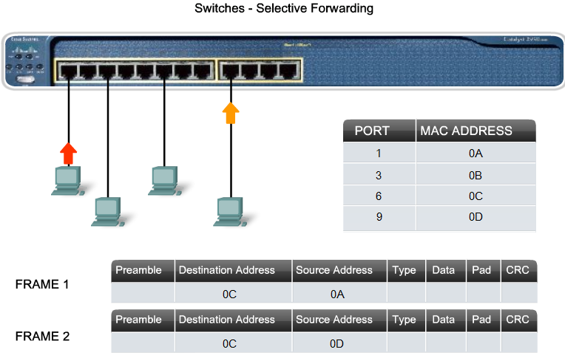
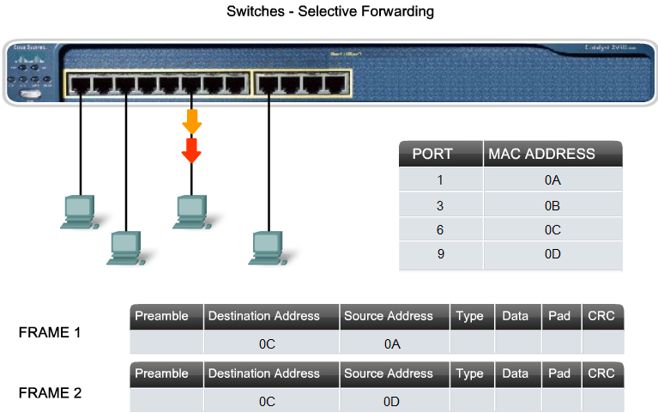
Compare and Contrast the Use of Ethernet Switches versus Hubs in a LAN

Slide 36
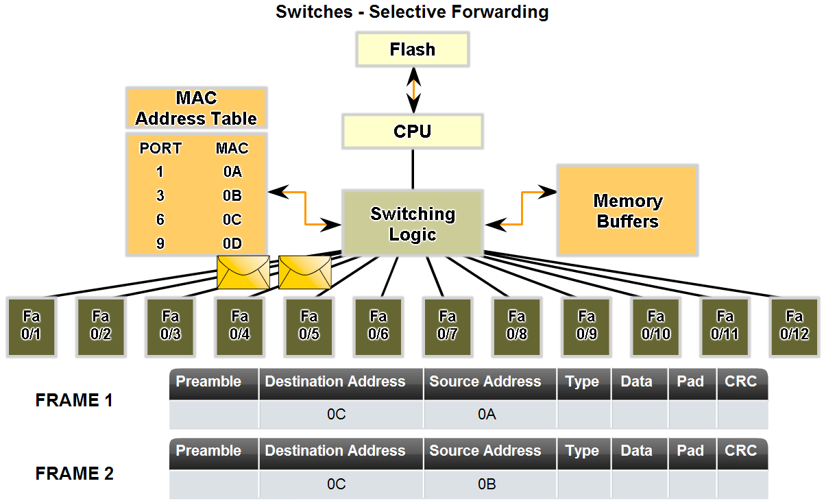
Compare and Contrast the Use of Ethernet Switches versus Hubs in a LAN.

Slide 37
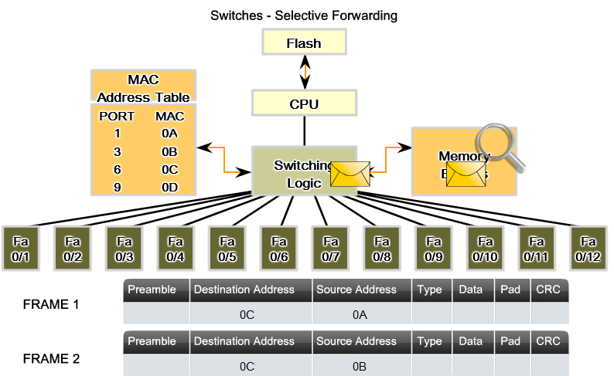
Compare and Contrast the Use of Ethernet Switches versus Hubs in a LAN.

Slide 38
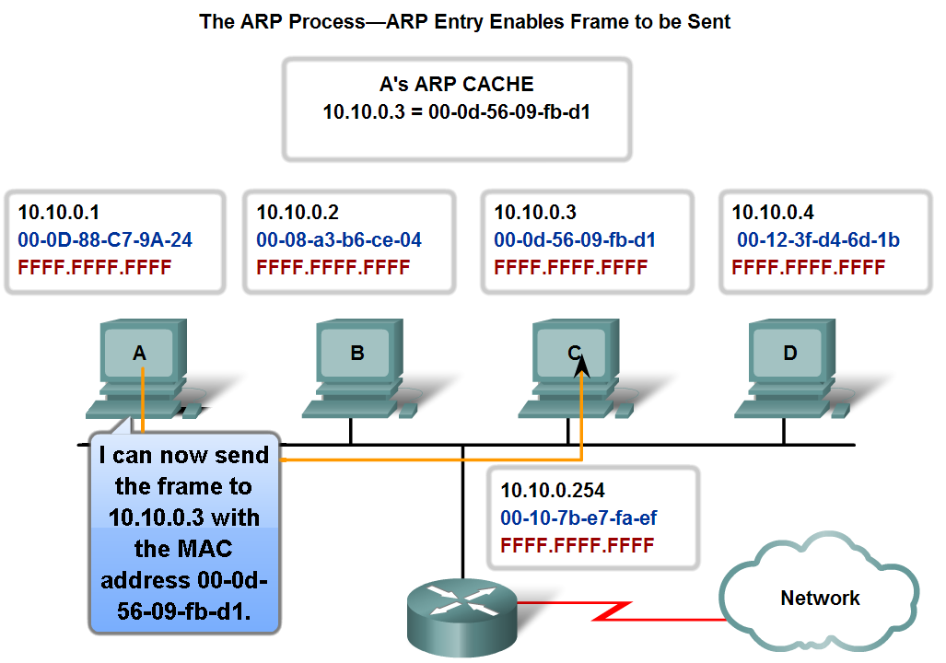
Address Resolution Protocol (ARP).
Mapping IP to MAC Addresses

Slide 39
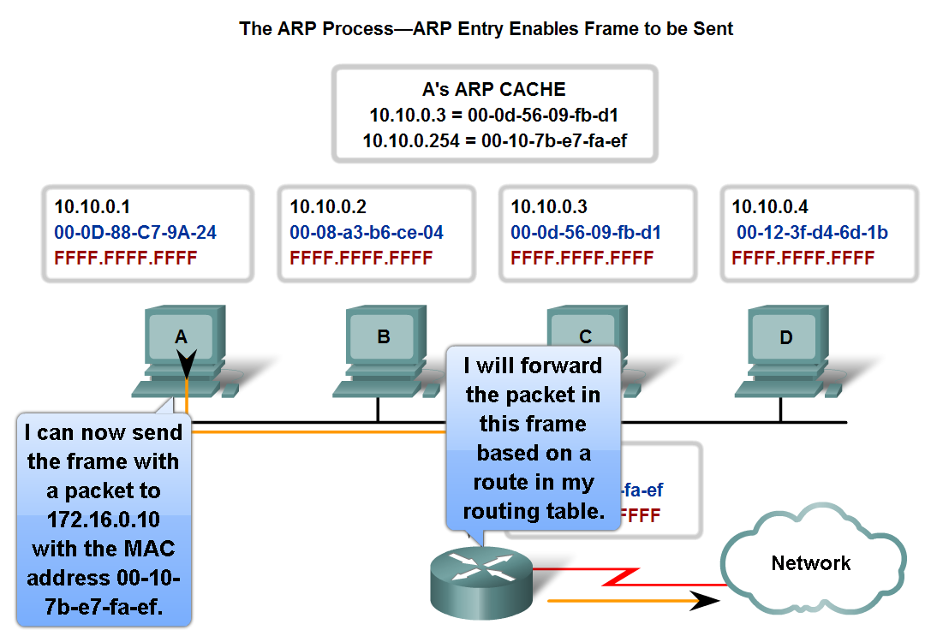
Address Resolution Protocol (ARP).
ARP – Destinations Outside the Local Network

Slide 40
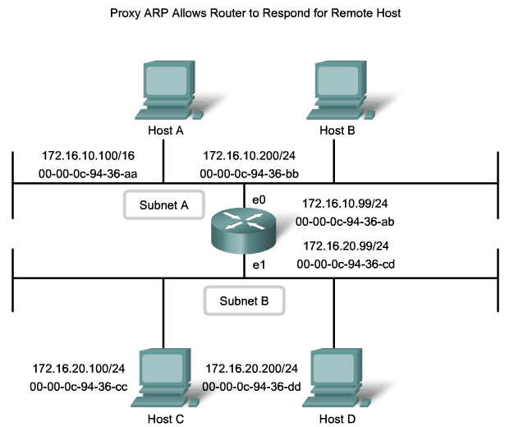
Address Resolution Protocol (ARP).
It happens when a host ask for MAC address which isn’t in the same LAN for any reason.
Router will act as a proxy gateway for that host.

Slide 41
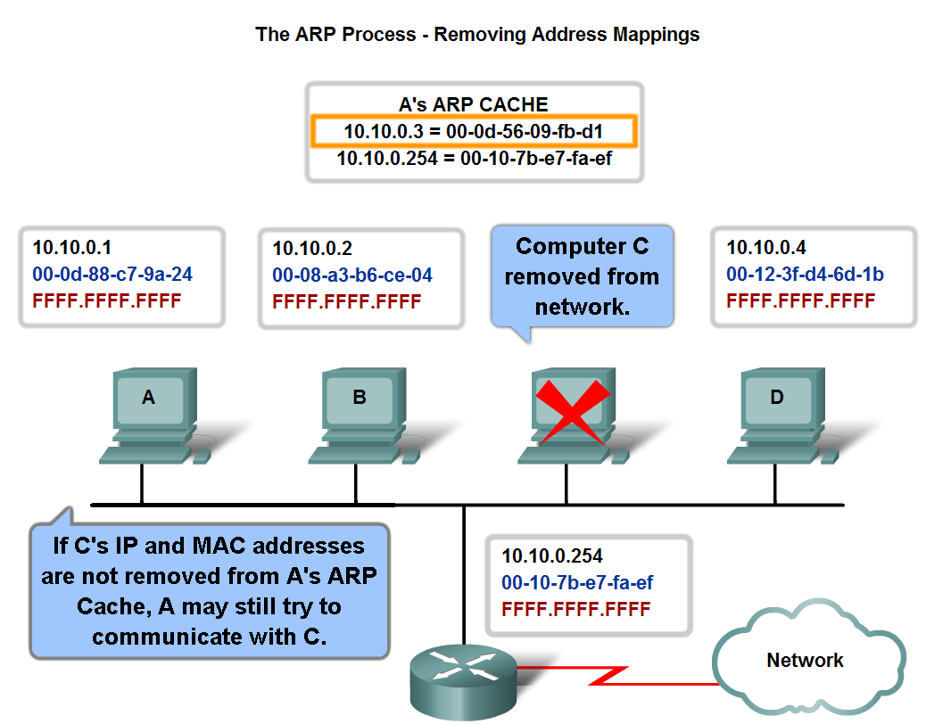
Explain the Address Resolution Protocol (ARP) process.
ARP – Removing Address Mappings

Slide 42
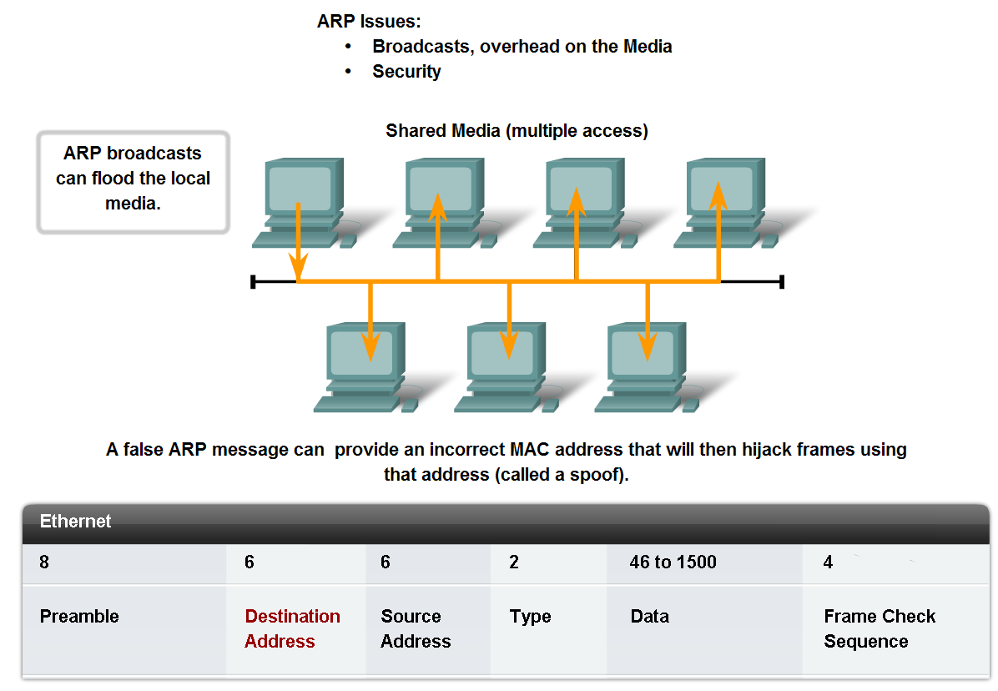
Explain the Address Resolution Protocol (ARP) process.
ARP Broadcasts - Issues

